Slide 1
Robust Training of Accurate Deep Learning Sequence Models for Fraud Detection
Antonio Martini

Slide 2
Why Deep Learning for Fraud Detection is Hard
Fraud is a rare-event, training data is extremely imbalanced. Not ideal for SGD based minimization.
The prescribed classifier operating point is extremely low and specified by business requirements. A typical operating point is an FPR in the 1-20bps range.
Cost functions employed in ML, in general don’t minimize a cost function that maps directly to the business requirements.
Minimizing a typical cross-entropy cost function is not the same as maximizing TPR at a given FPR. This is achieved indirectly.

Slide 3
Sampling Methods for Highly Imbalanced Data

Slide 4
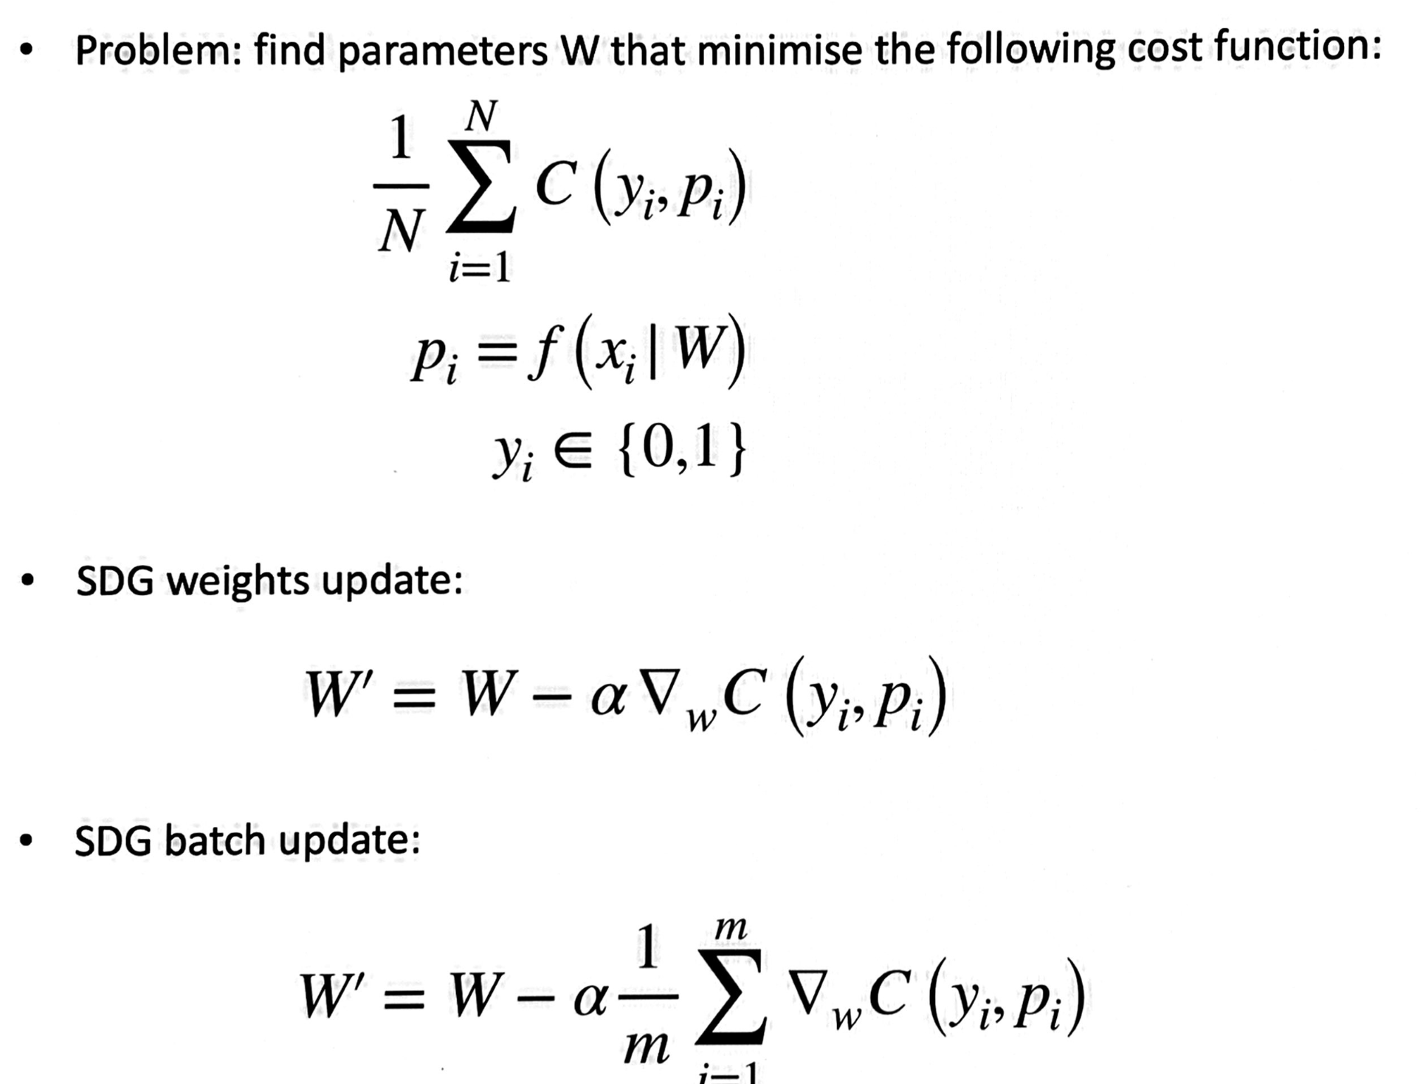
Preliminaries and notation

Slide 5
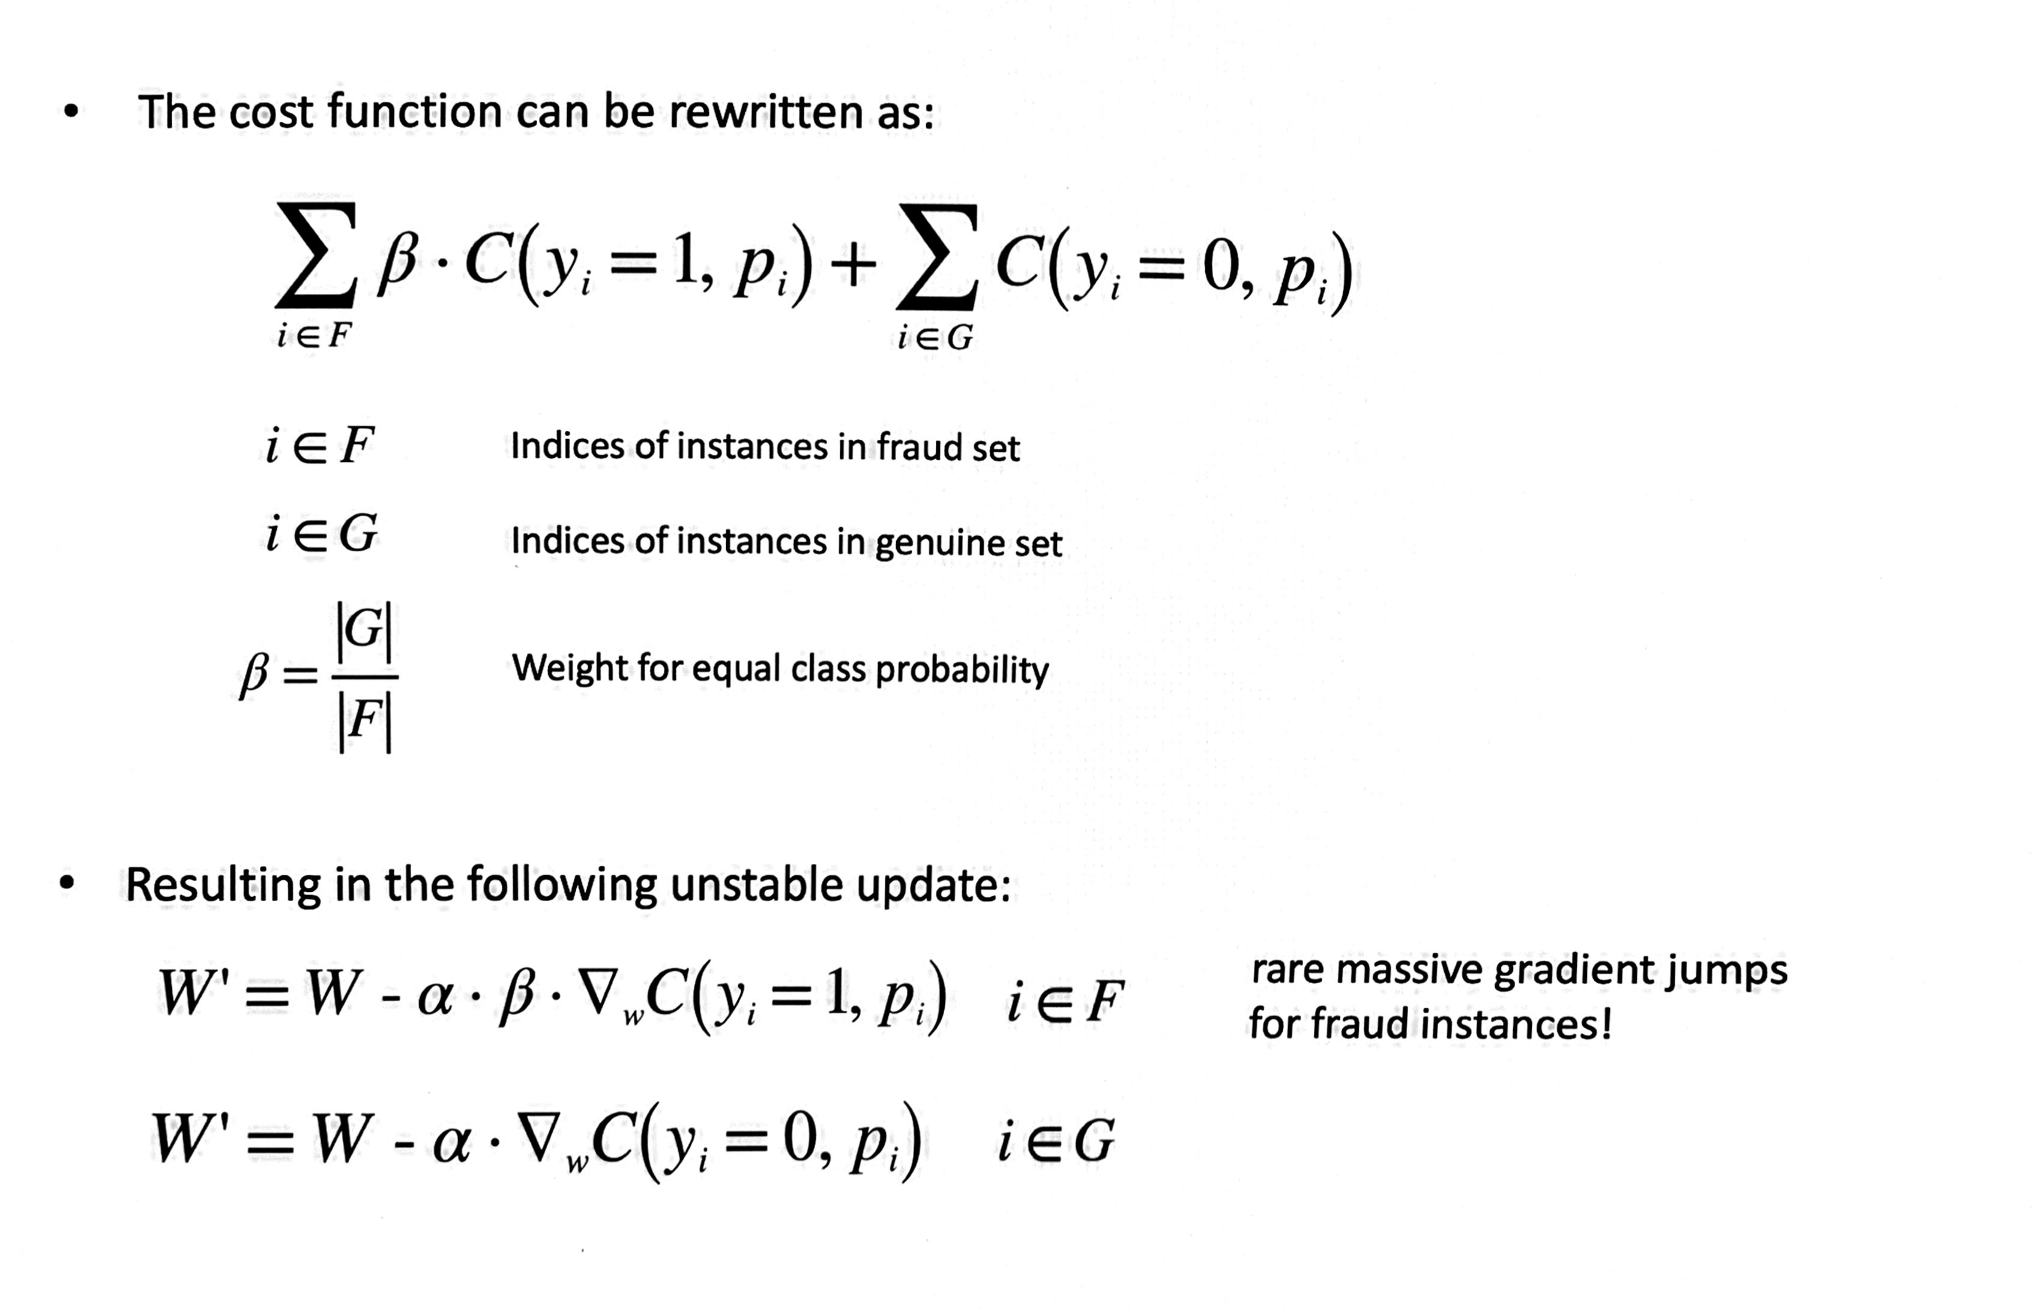
Minority class up-weighting leads to unstable updates

Slide 6
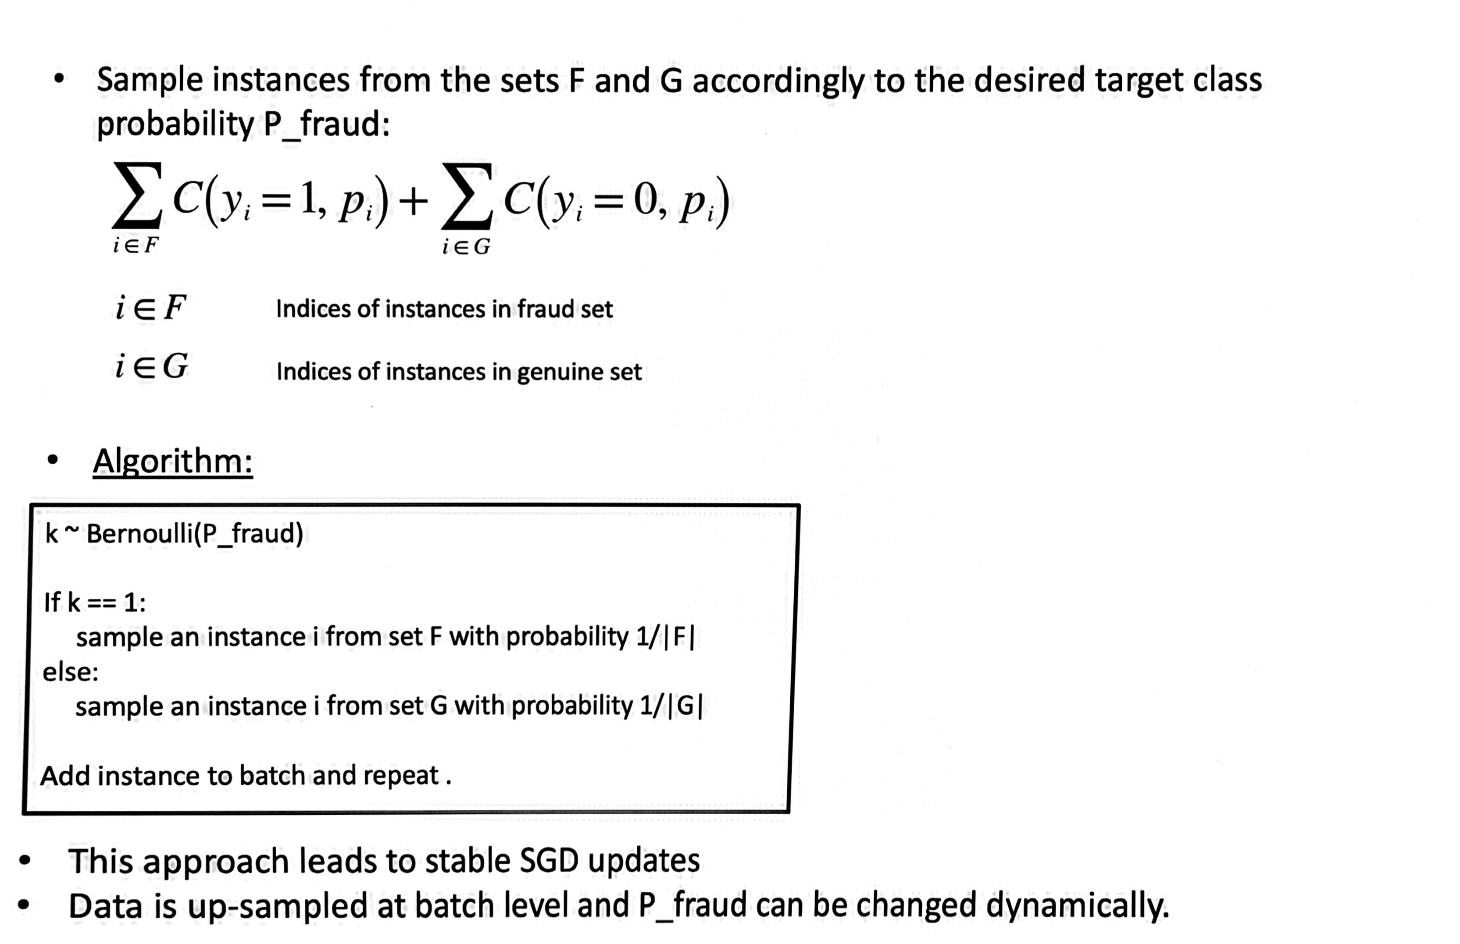
Minority class up-sampling is stable and allows for curriculum learning

Slide 7
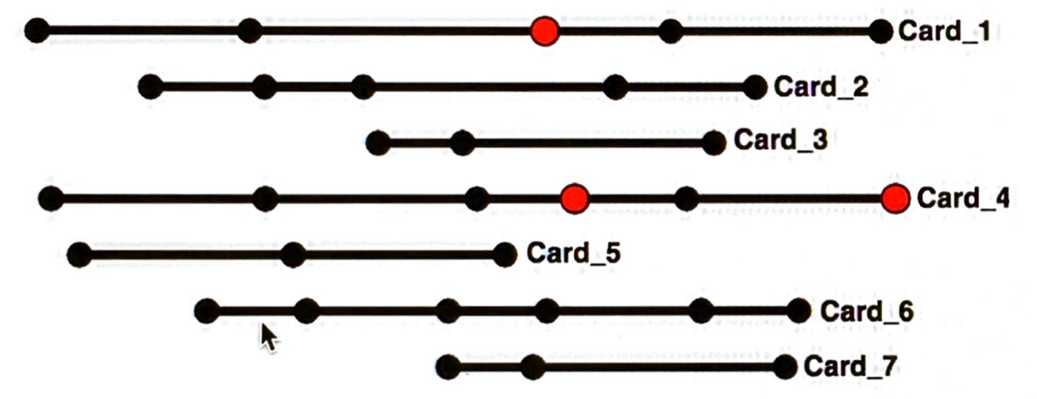
Sequence data exacerbates the class imbalance problem.
Replace ”Card” with any sequence of events you like.
We have a few rare events with a ‘positive’ label within a small sub-set of sequences.
Most of the data is made of sequences of ‘negative’ events.

Slide 8
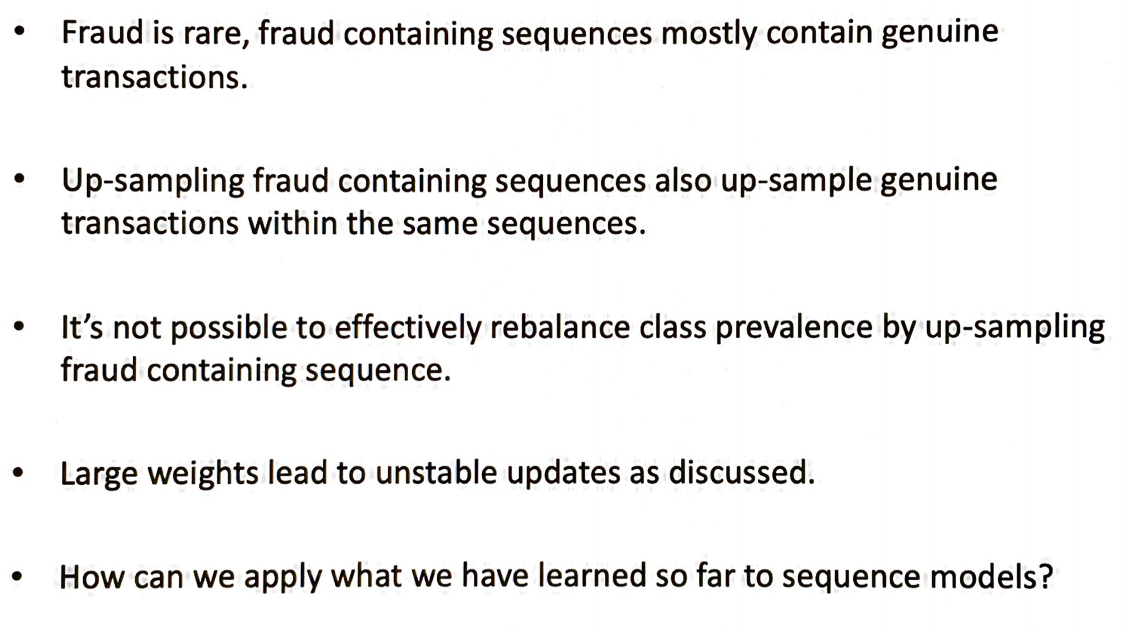
Sequence data: some facts

Slide 9
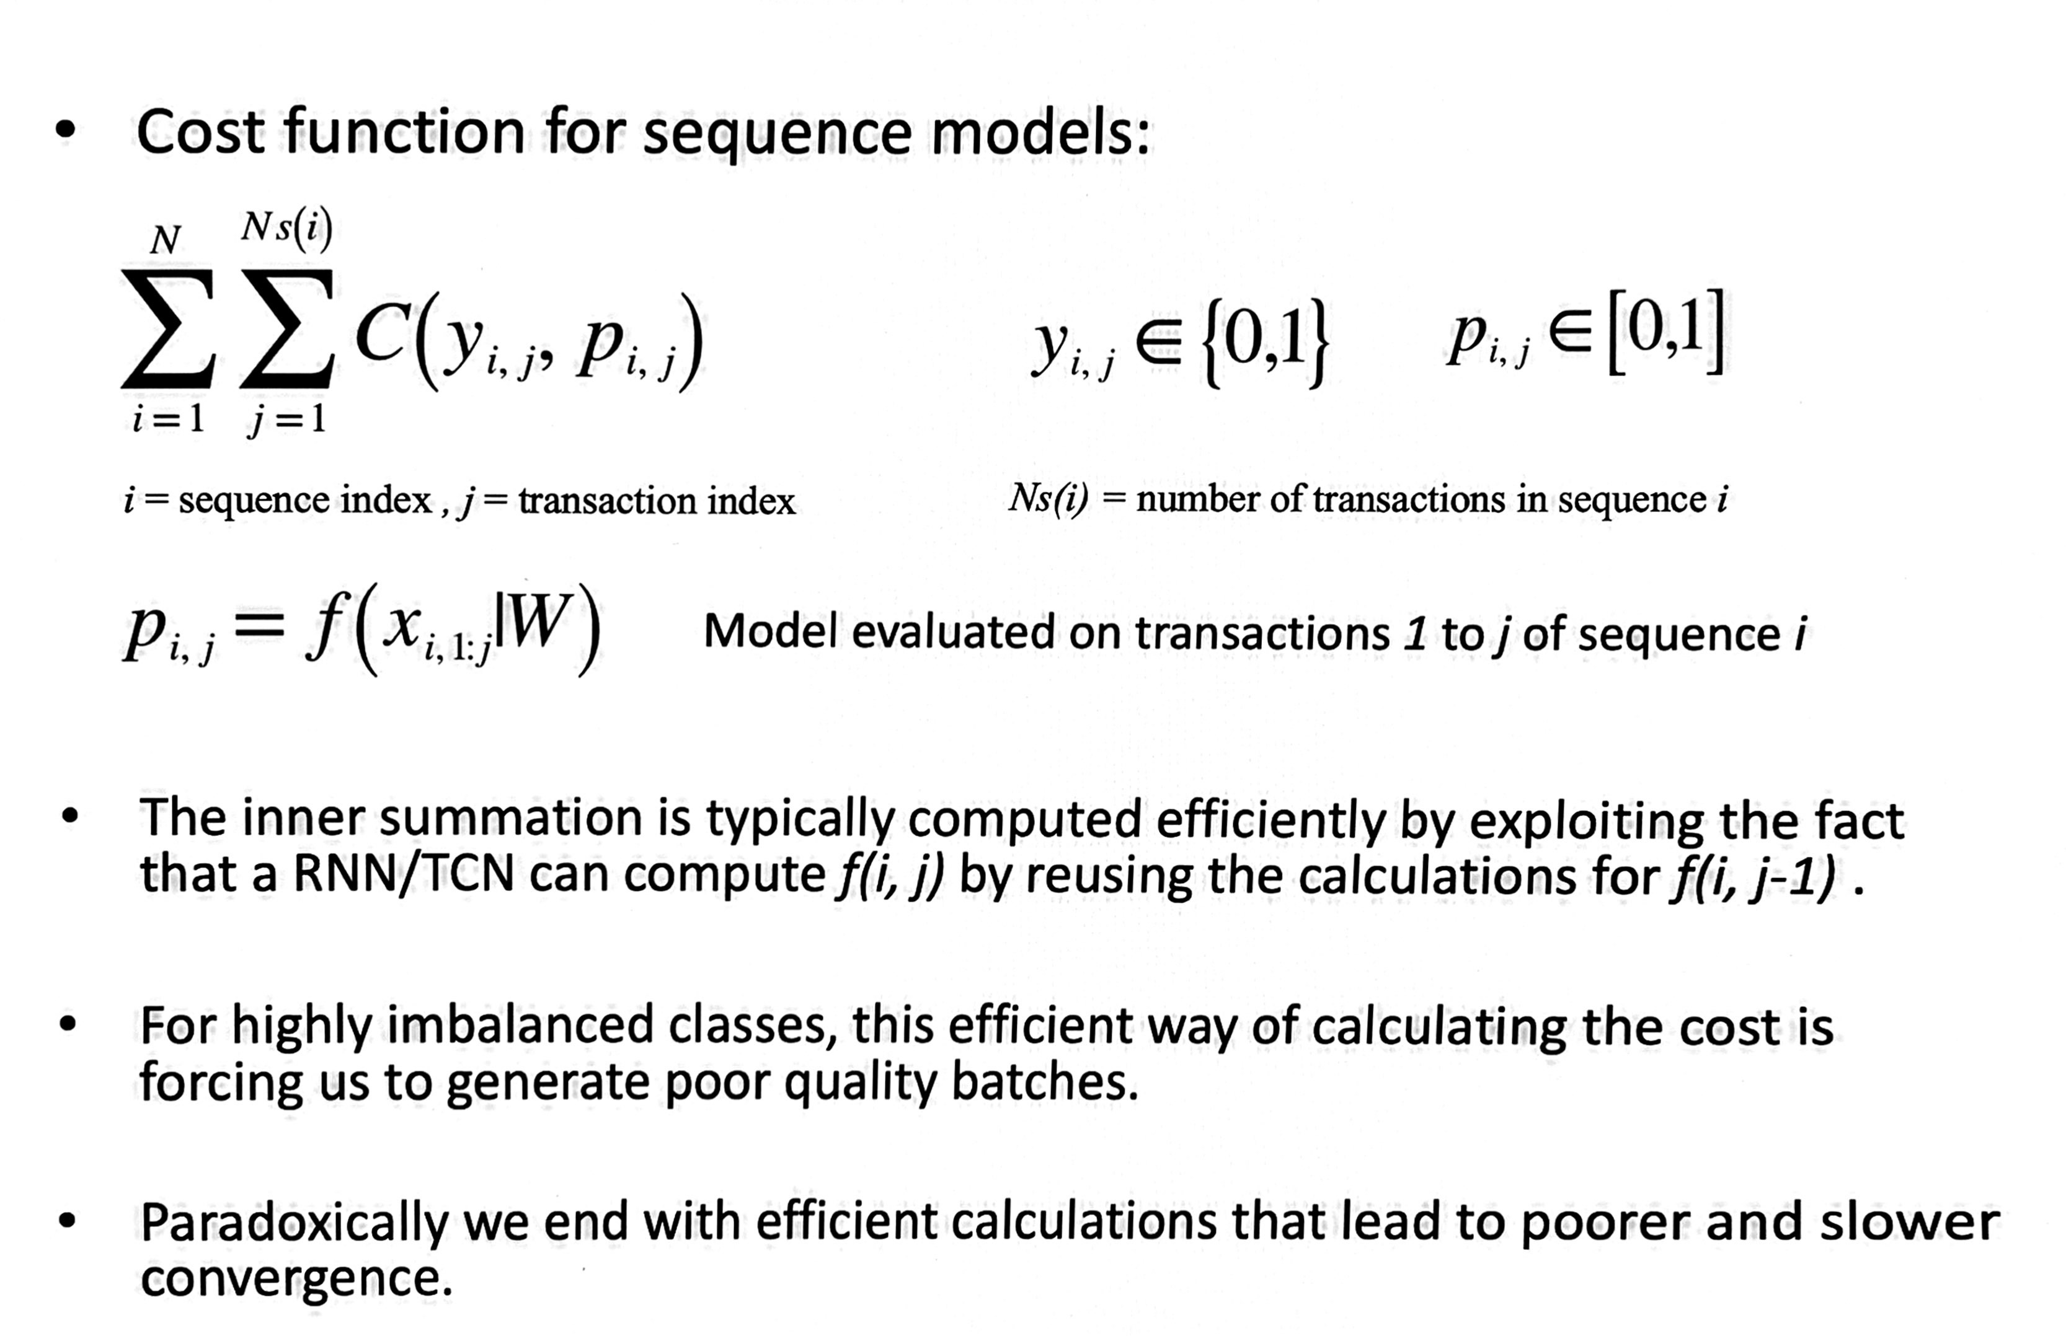
Cost computation for sequence models

Slide 10
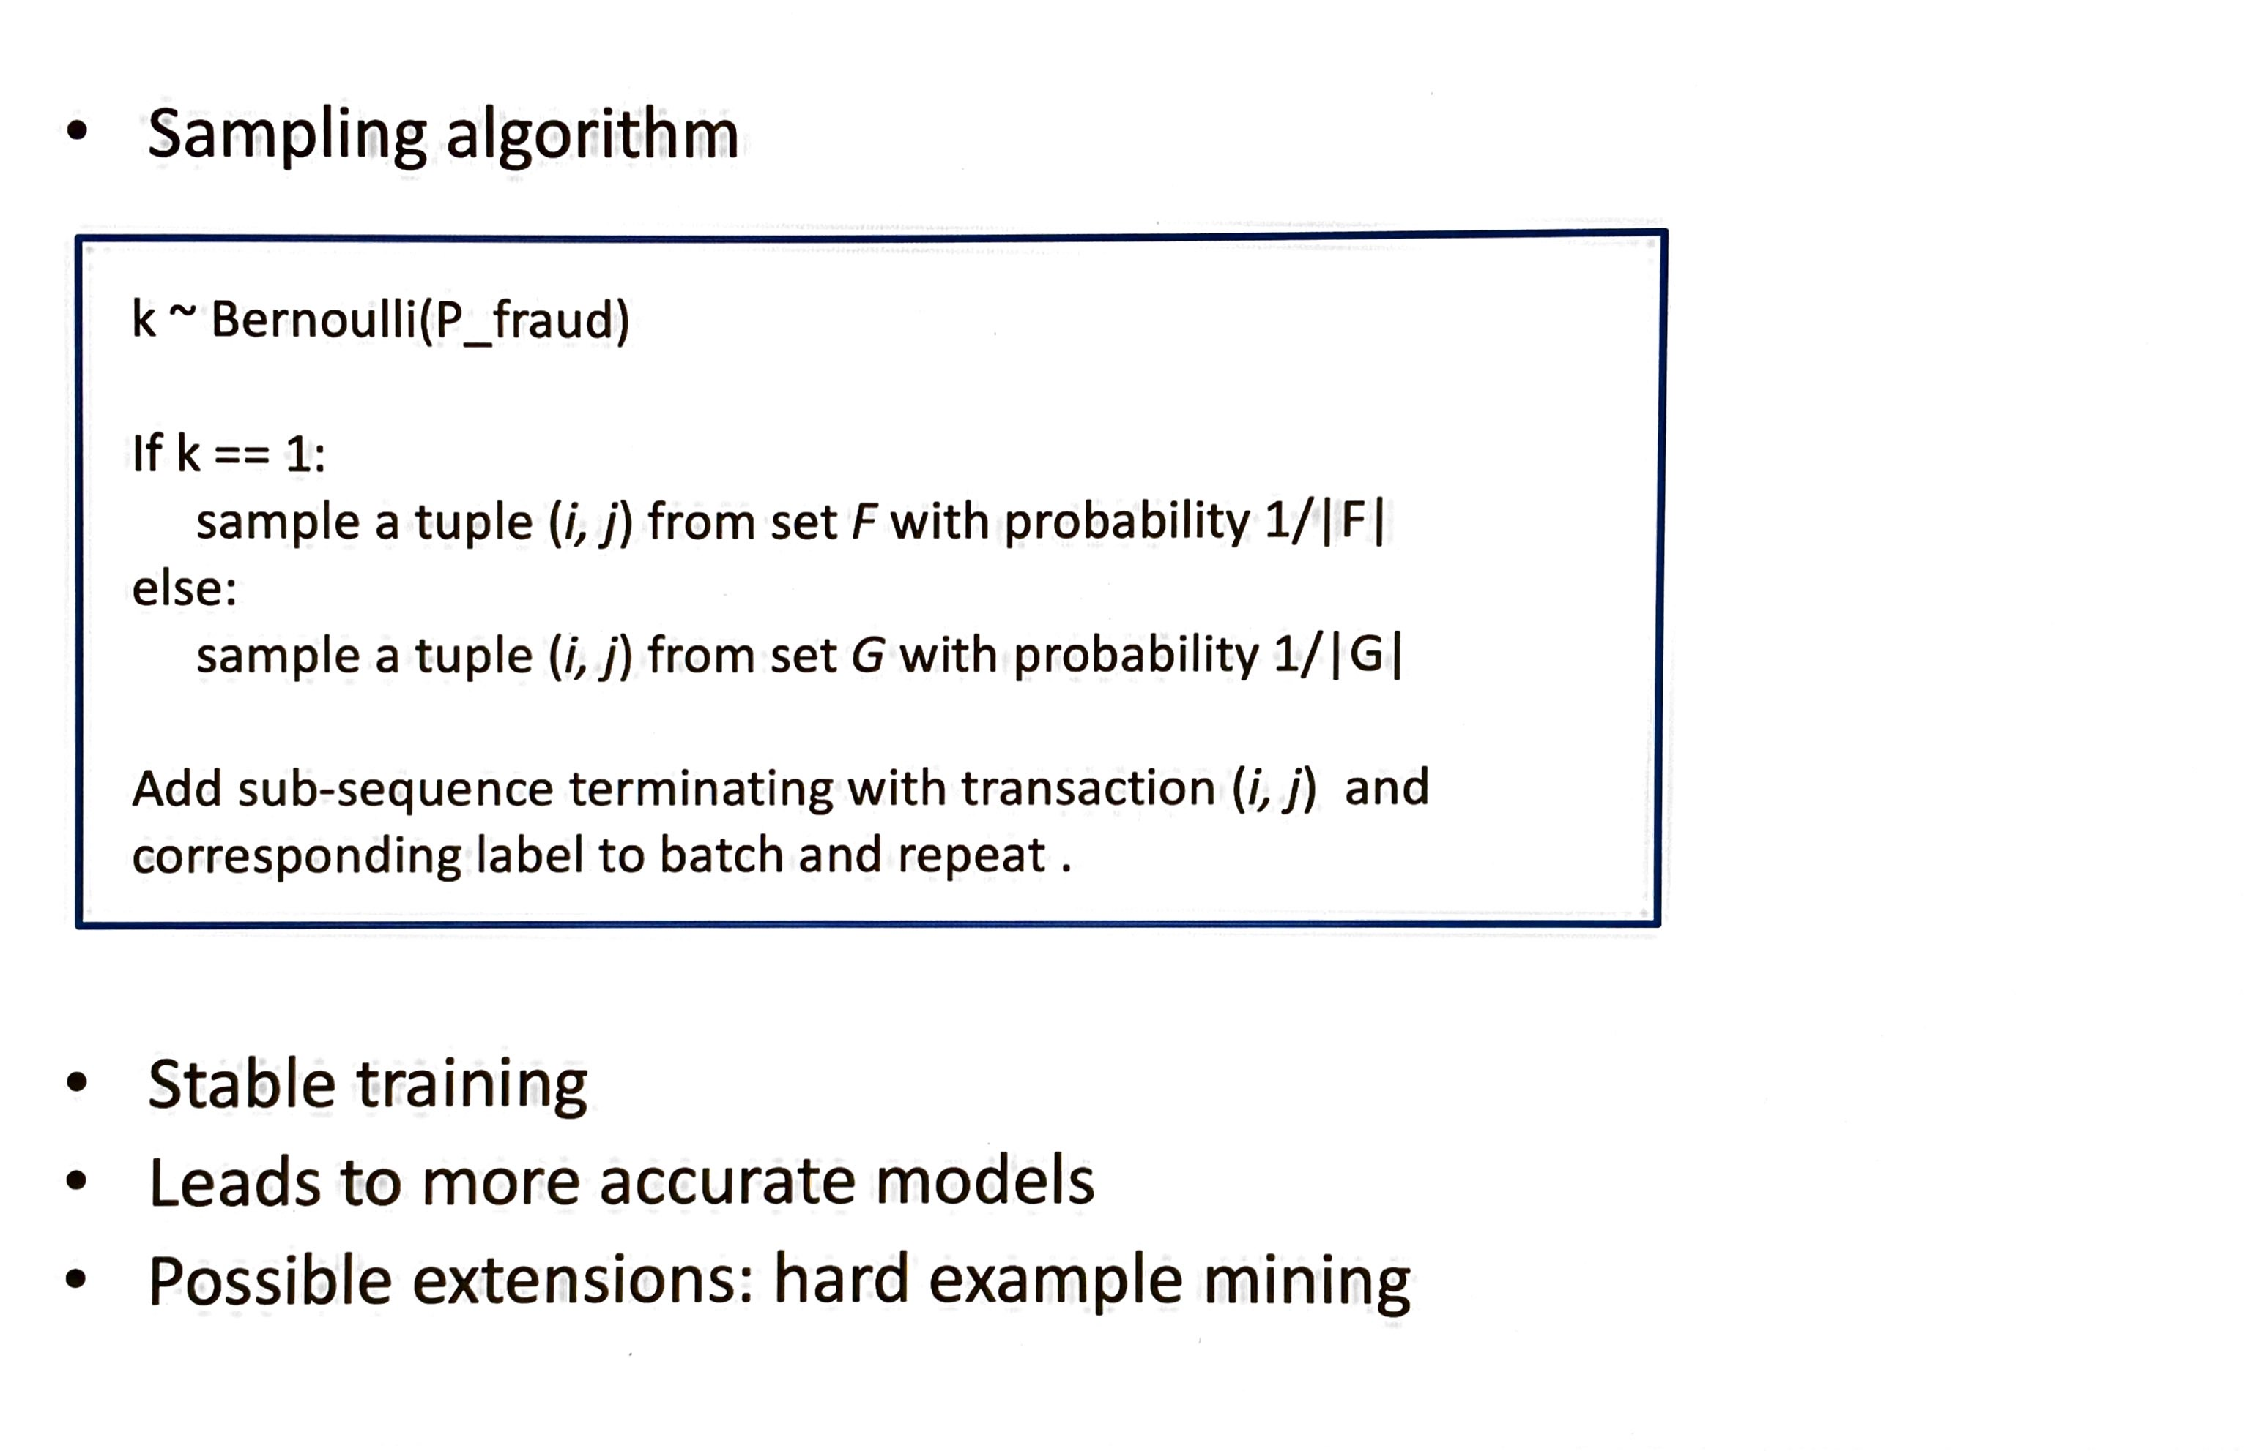
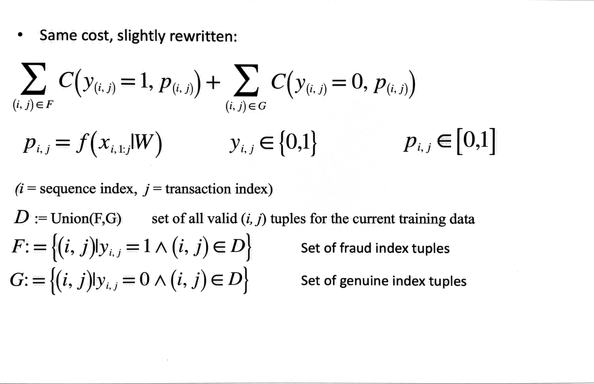
We can re-write the cost in a sampler friendly format

Slide 11
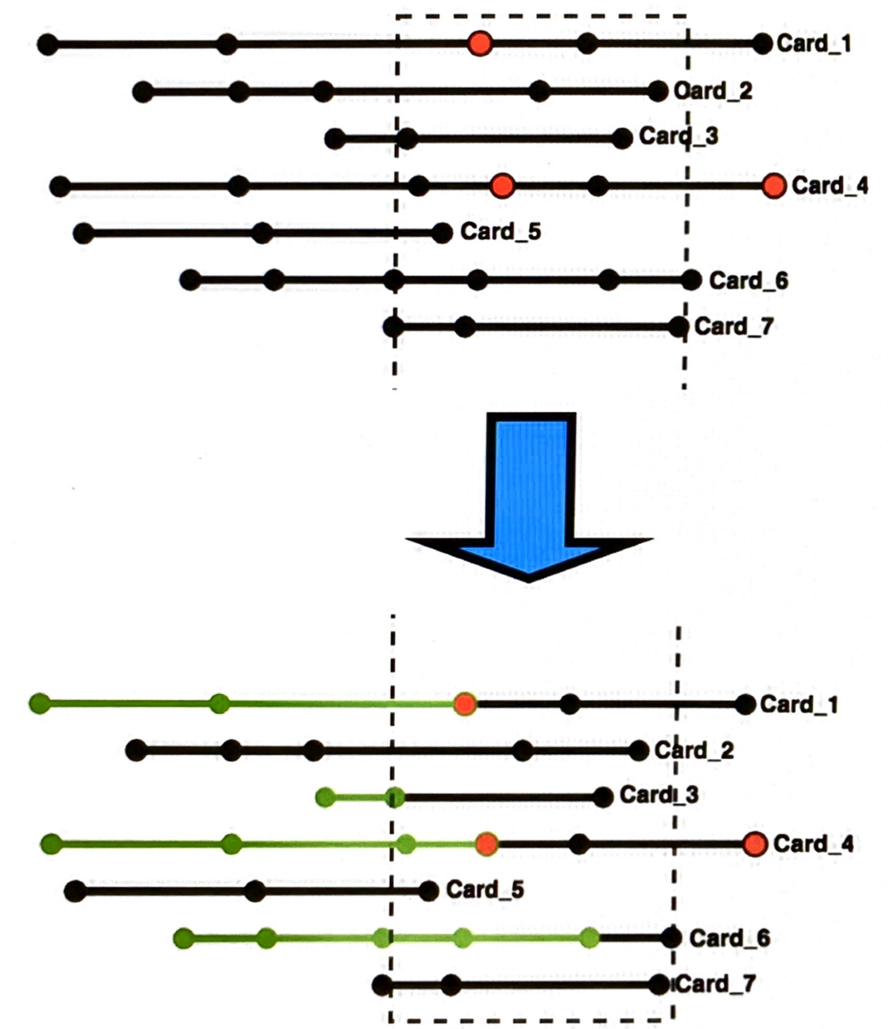
The re-written cost allows for stratified sampling

Slide 12
Cost Functions and Asymmetric Focal Loss(AFL) for Fraud Detection

Slide 13
Requirements for a good cost function
The business requirement is usually specified as maximizing TPR for a given FPR.
We are interested in the ROC when the FPR is very close to 0.
Our cost function needs to relate as closely as possible to the business requirements.
Further It needs to be amenable to numerical minimization within a SGD framework.
The minimization must be implementable within the available hardware resources.

Slide 14
Some options that go towards meeting our requirements
Focal Loss(FL)
Partial Area Under the Curve(pAUC)
Cross-Entropy
Logistic Push
Global Objectives

Slide 15
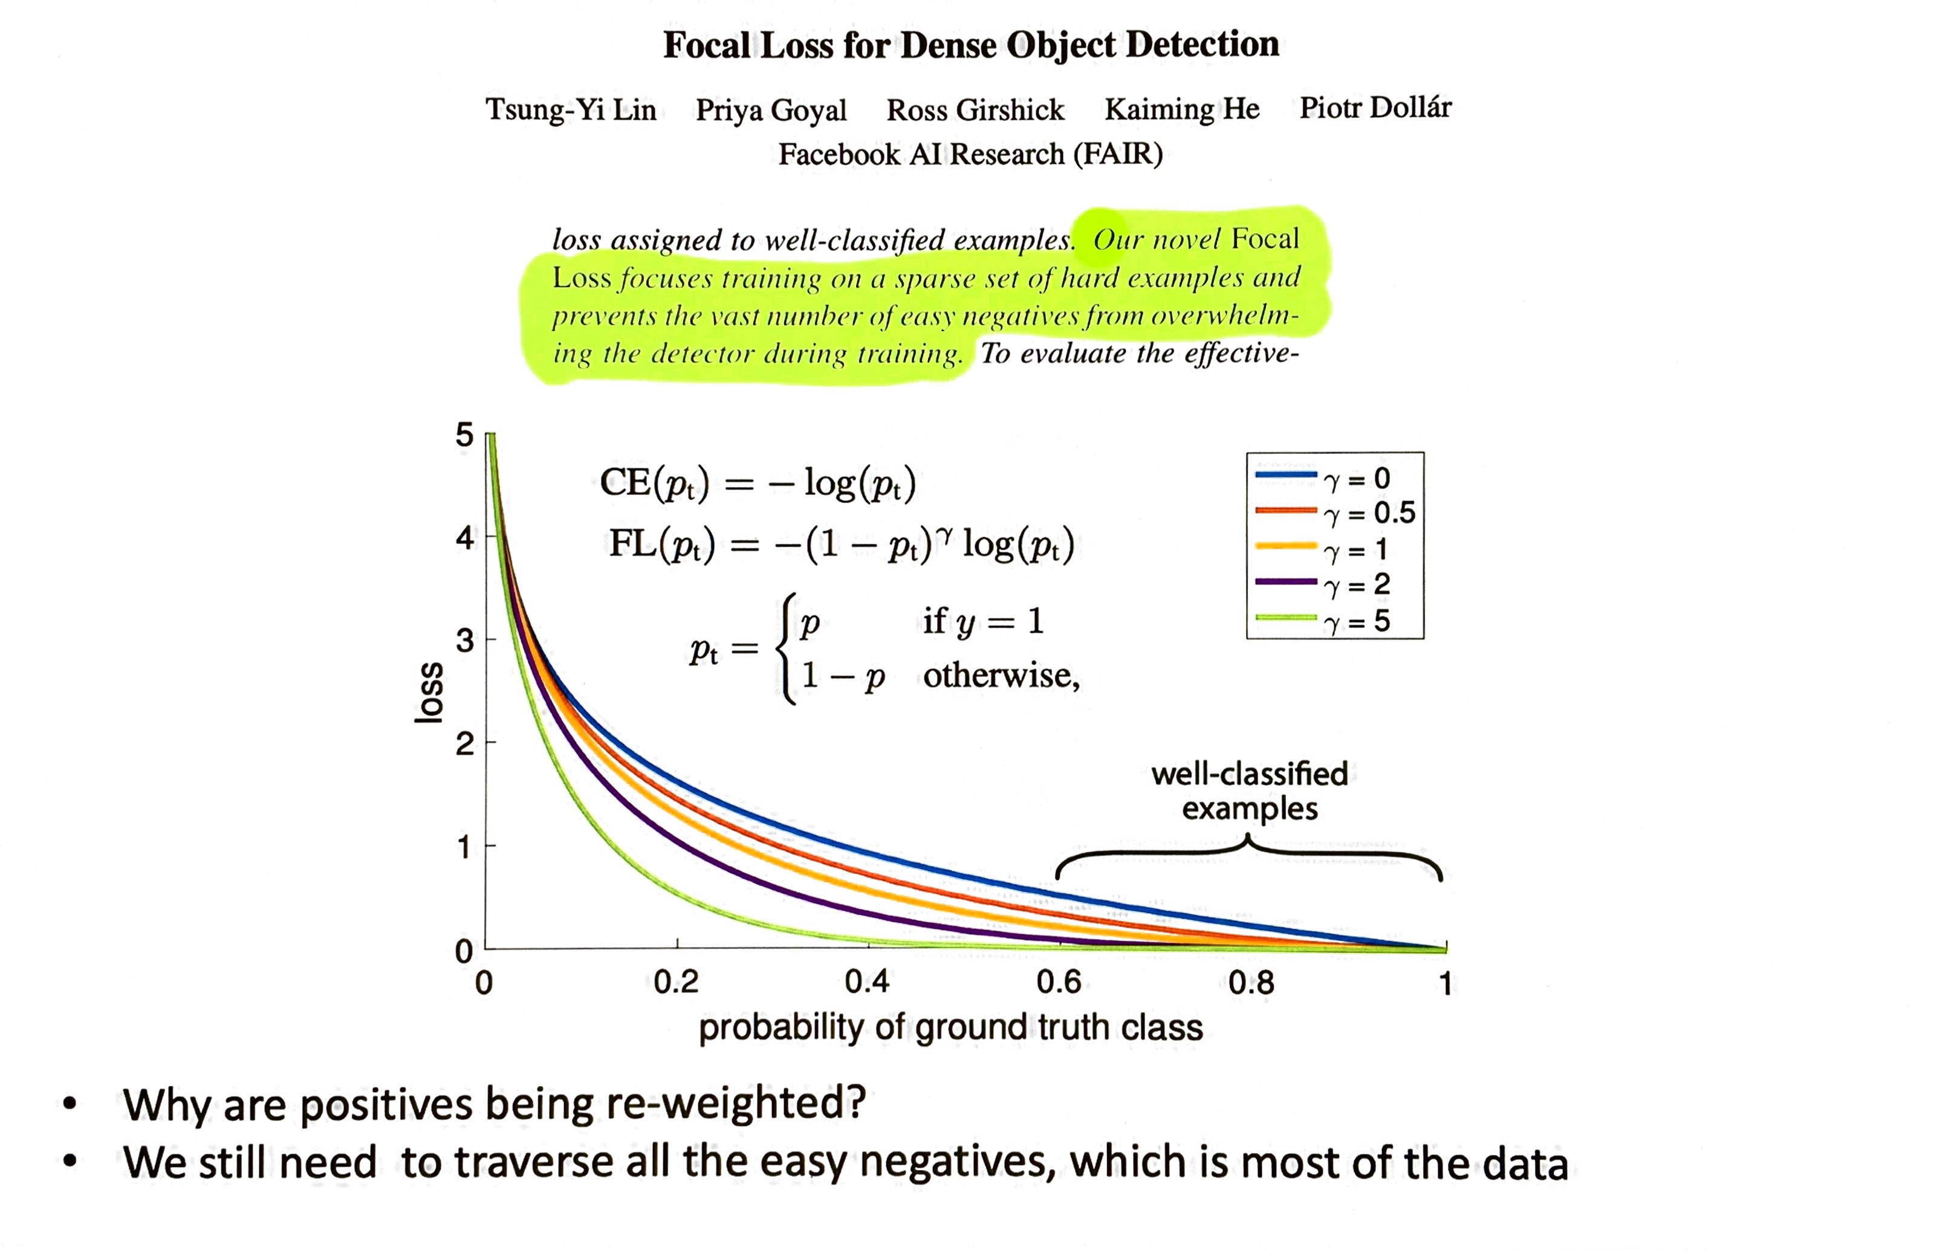
The Focal Loss was designed to deal with class imbalance

Slide 16
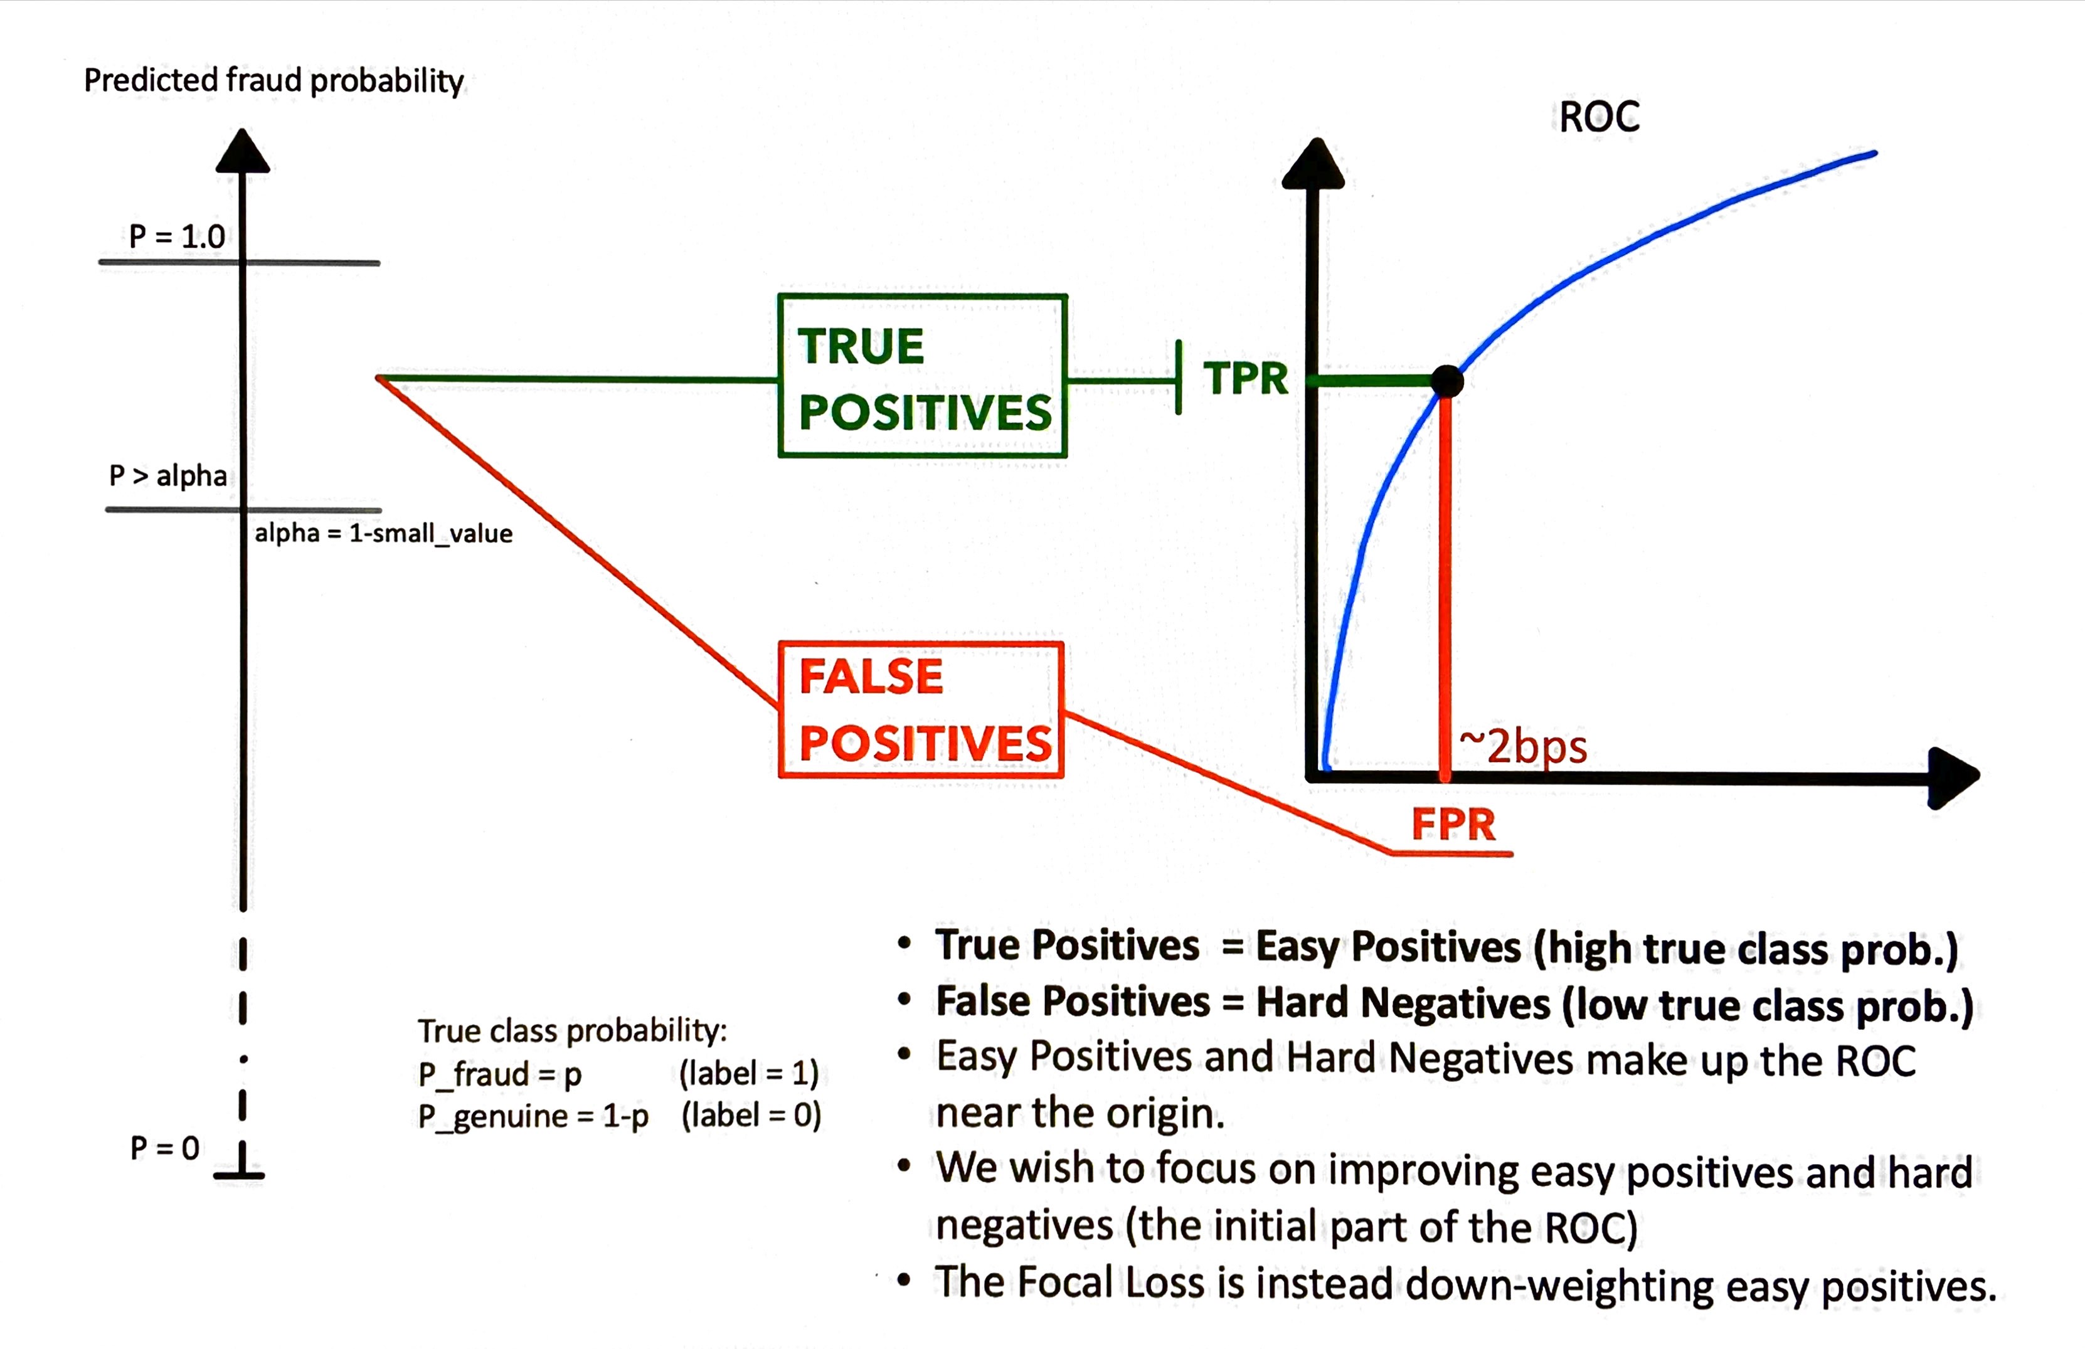
Focal Loss with balanced classes

Slide 17
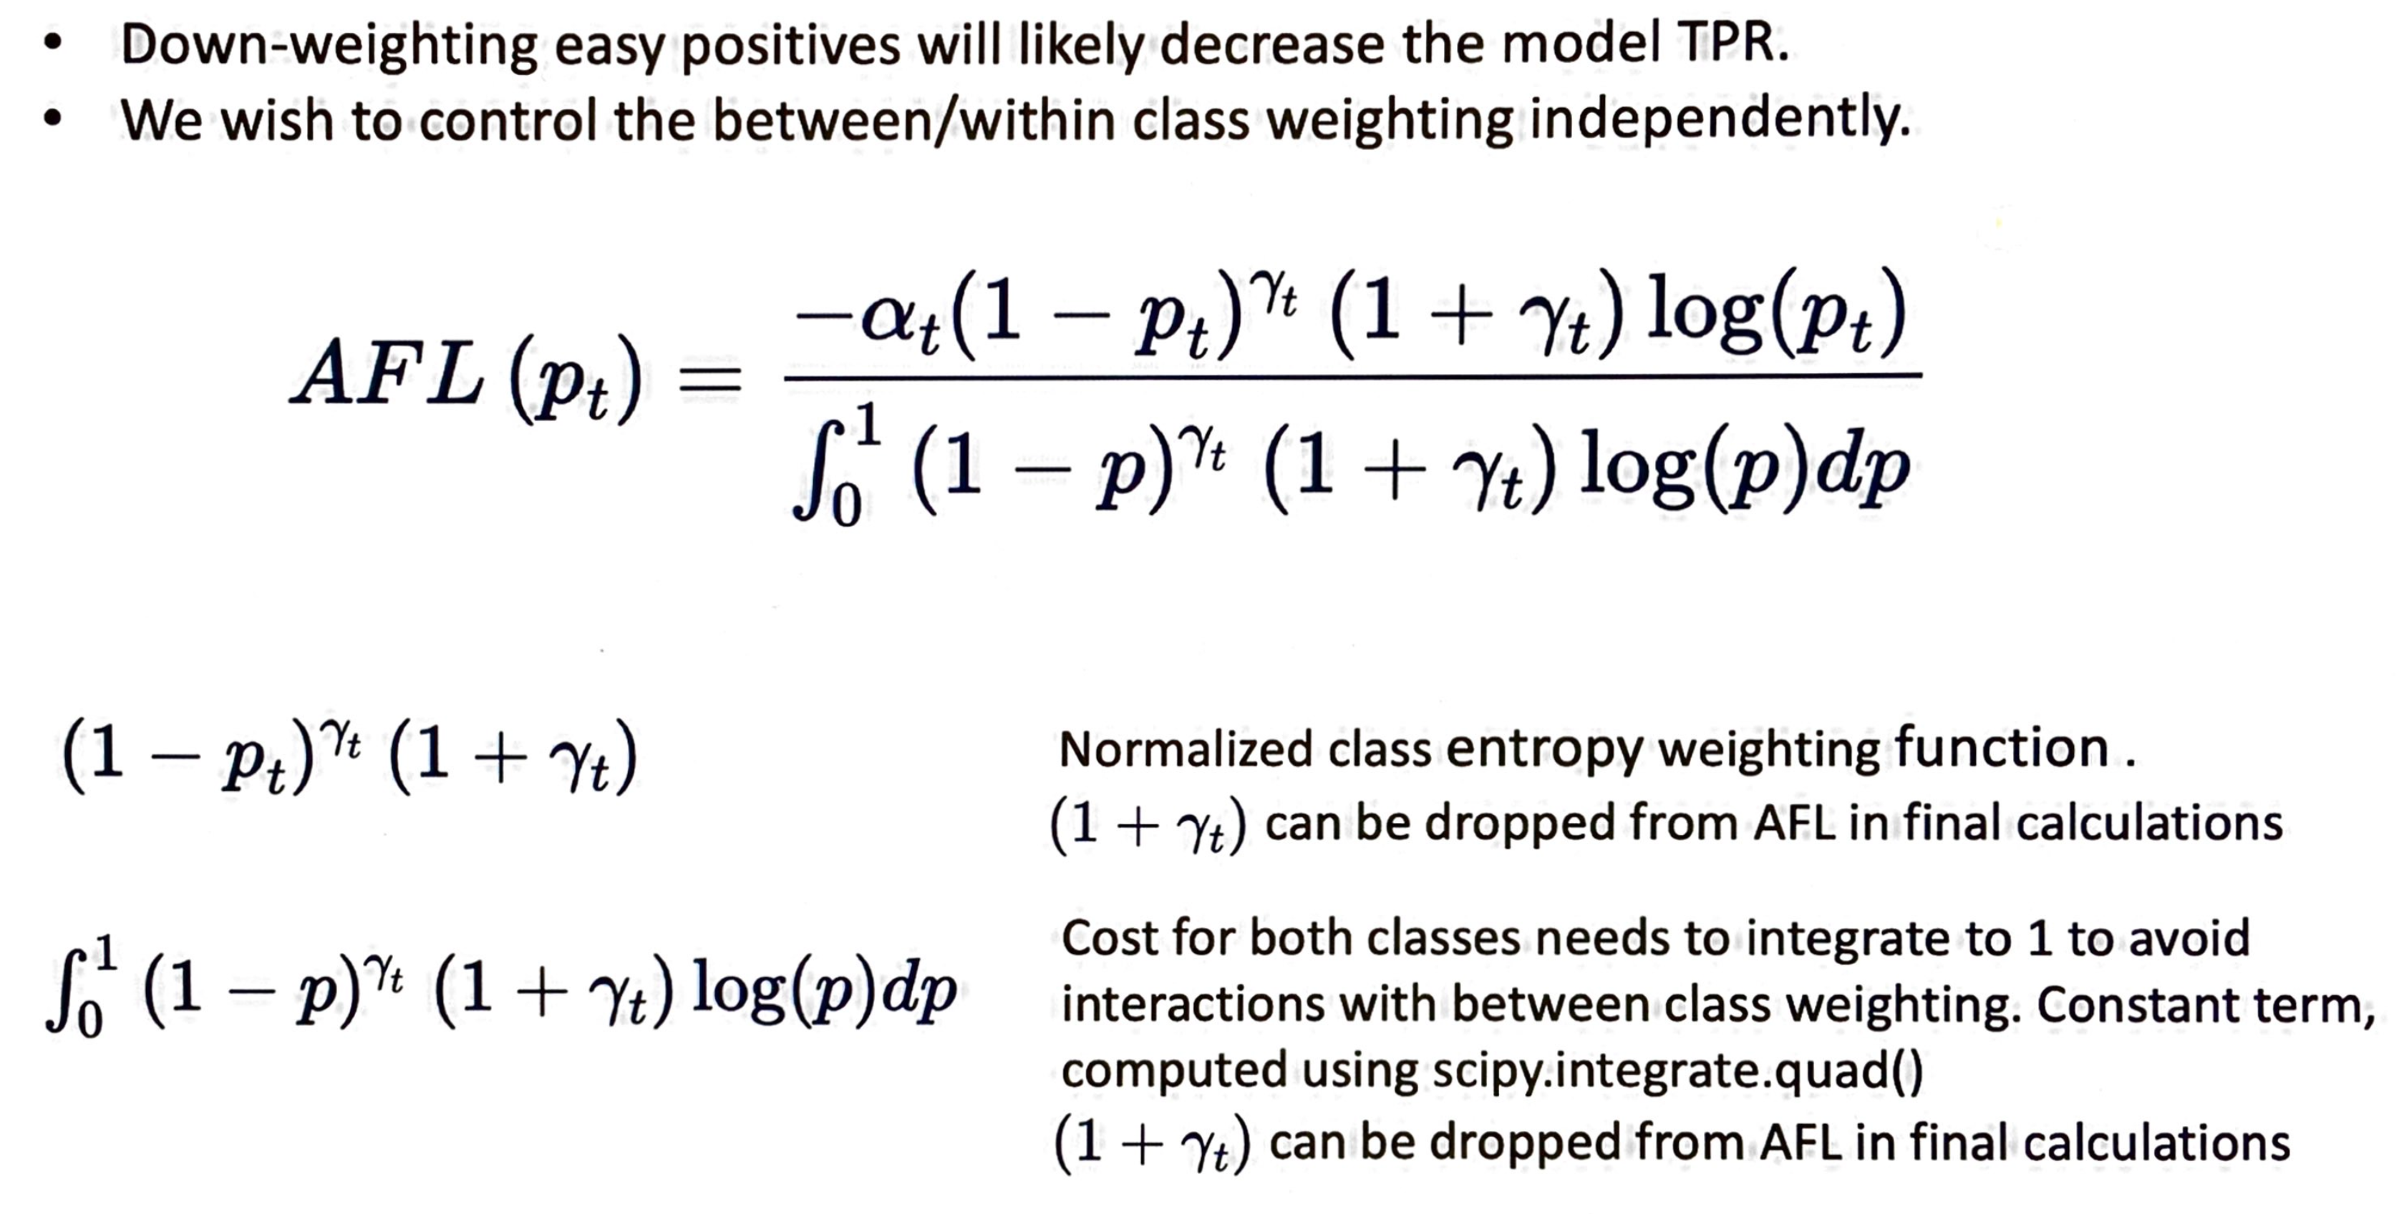
Asymmetric Focal Loss (AFL)

Slide 18
Results: results cannot be publicly shared, however…
Using conventional sampling and cross-entropy cost, our sequence models performed worse than state of the art GBM models.
After employing the discussed sampling schemes and asymmetric focal loss they now easily outperform GBM models.
Good hardware(NvidiaDGX-1) made all the difference, but even better hardware could make even more difference.
Improvements are still possible

Slide 19
Discussion

Slide 20
The limitations of data re-weighting
Re-weighting data instances mitigates overfitting during training and gives some control on the ROC near its origin.
However the weighting function is rather arbitrary. Although its parameters could be adjusted dynamically (in theory).
Conceptually it seems more effective to create mini-batches by sampling instances based of a measure of fit.

Slide 21
Hard-example mining: some options
Create mini-batches by performing importance sampling based on cost function.
Requires re-evaluating the cost for the whole data before sampling a mini-batch. An approximation may work.
Sampling from a data stream becomes very challenging.
Requires super-fast storage devices, NVMe (Non-Volatile Memory Express) SSD etc…

Slide 22
QA

